Slide 1

The future of food-based
social networking
Team G: Vasant Bhardwaj, Ryunosuke Saito, Abhi Mohani, Anish Kulkarni

Slide 2
Current Needs
Meet Sam:
He’s a white sophomore at Johns Hopkins University who wants to cook Vietnamese food for his new girlfriend’s family to show appreciation for her culture.
Problem is, he’s a novice cook who needs help cooking such a complex dish!

Slide 3
Current Needs
Meet Sally:
Sally is a middle-aged chef who has worked at a Vietnamese restaurant in Los Angeles, CA, for years. She connected with her kids through cooking and wants to have the same experience with other people interested in cooking.

Slide 4
Solution?

Slide 5
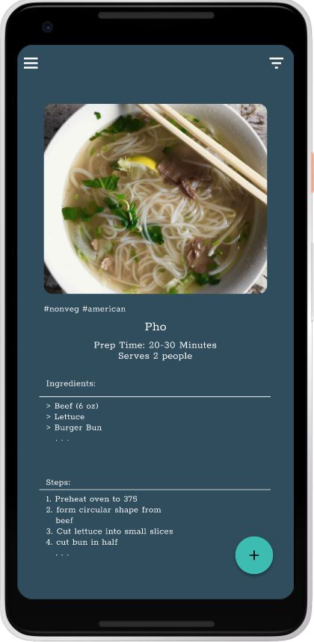
Solution: CooksNest
When Sam meets Sally.
Sam connects with Sally on CooksNest after swiping right on a pho recipe she posted.
He follows the recipe the best he can, but he’s still having trouble...

Slide 6
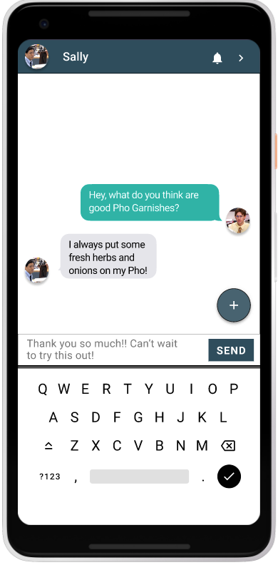
Solution: CooksNest
Sam reaches out to Sally!
Sam hasn’t cooked a dish with garnishes before, so he messages Sally on the app about her recommendations for what garnishes to use.
Sally immediately responds, and helps Sam through the cooking process.

Slide 7
Solution: CooksNest
Thanks to CooksNest, Sam makes a delicious meal for his girlfriend’s family, and he improves his skills as a cook!
Because Sam swiped right on Sally’s pho recipe, the recipe gains more attention on the app!

Slide 8

Other Personas
Sara is an Asian student at Duke University who became interested in cooking during quarantine, and she has been spreading her love by making an Instagram account for sharing recipes. While she has more than 600 followers--and reaches over 1000 accounts per post--she realized that using Instagram only allows her to connect with people that are also passionate about cooking.
She believes that her recipes are fairly easy to cook and she hopes there are social media apps that focus on cooking so she can share her recipes with novice chefs to get more people into cooking.
Sara

Slide 9

Other Personas
Andrew is a father of two who just found out that his son, Chad, is lactose intolerant. While he has experience cooking, he does not know many recipes that would fit his son’s new dietary needs. He found recipes online, but he struggles with re-creating them at home. He wants to learn how to cook good, healthy food for Chad from someone with experience, and he wants to be able to ask people for advice so his recipes are safe for his son.
Andrew

Slide 10
User Research: Questions
Do you use any social media to look for recipes? If so, what do you use?
Would you download a social media app solely dedicated for recipes and cooking?
What features would you want in a recipe app with social media aspects?
Where do you buy your food? Do the supermarkets that you shop at have a variety of ingredients?
Which App Name do you like best?
Cooksnest
Munche
Kytchen
Foodyy
Do you have anything else?

Slide 11
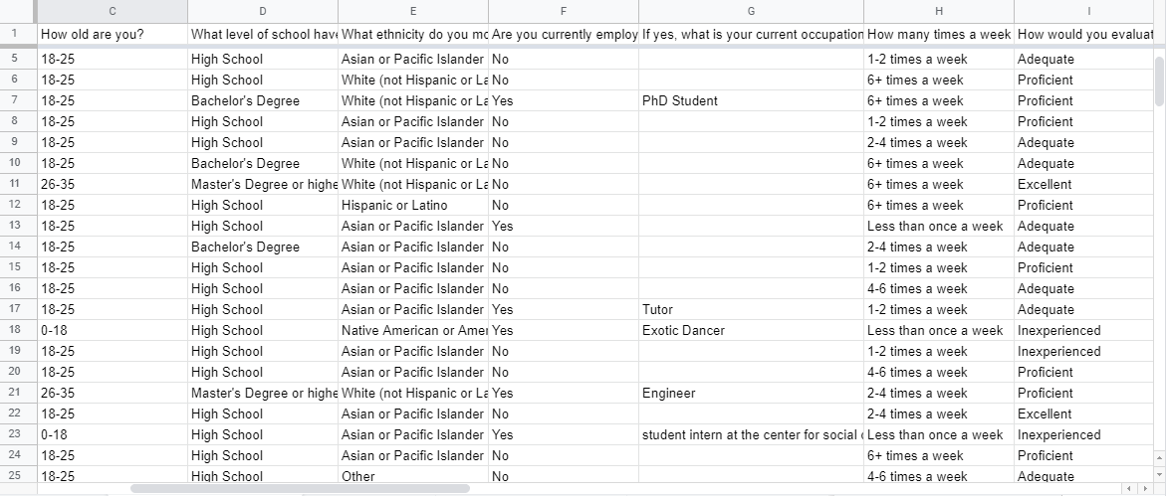
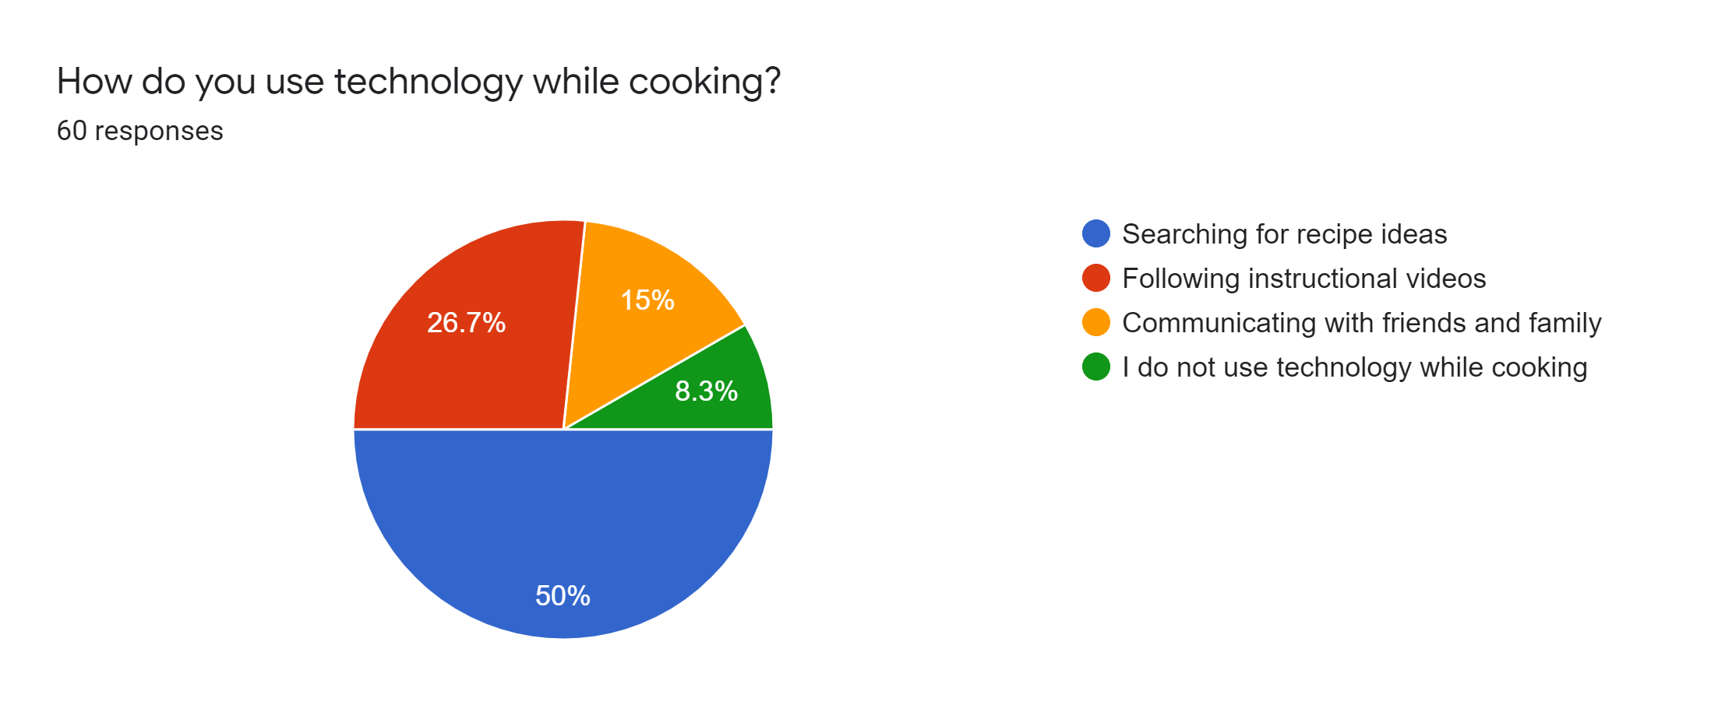
User Research: Results

Slide 12
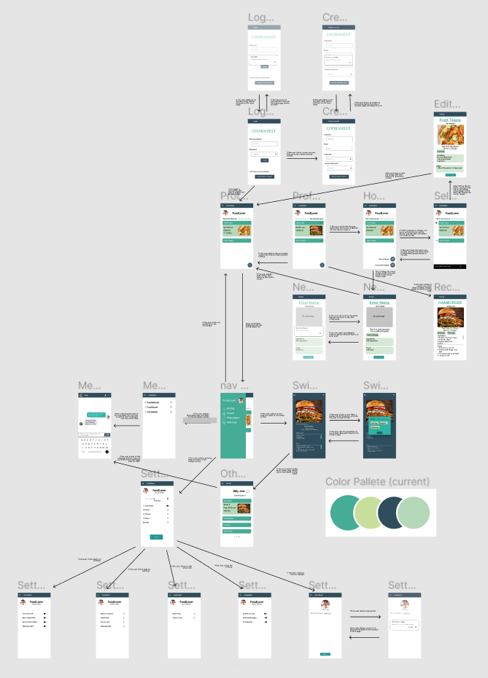

Slide 13
App details
https://prezi.com/view/bPmztIVkVzAFjlR1GOll/

Slide 14
Design Justifications: Features (for grader)
“Swipe” feature
We chose to implement a swipe-based model to simplify user decisions and retain user attention
This is supported by extensive data (see right)
Its left-right orientation also aligns with the way that we read and visualize time. Unlike other means of executing commands … swiping is a much faster motion and quickly becomes almost subconscious … swiping can be key to retaining the user’s attention.
(App Partner Academy, 2018)

Slide 15
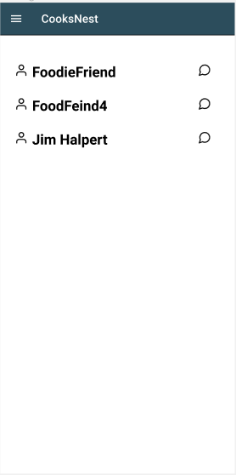
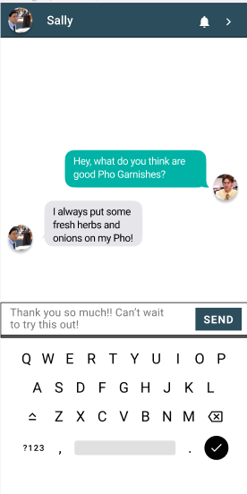
Design Justifications: Features (for grader)
Messaging feature
We chose this feature to allow for ease of communication, since built-in messaging is safer and easier than exchanging personal contact info
We chose to make the layout and feel of the messaging system similar to that of system messaging app (iMessage or Android Messages), to make it more intuitive for the user

Slide 16
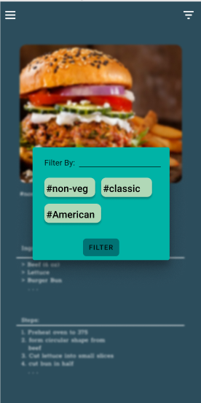
Design Justifications: Features (for grader)
Feed Filters
We chose to include filters to allow users to narrow the recipes on their feeds based on their moods and needs (i.e., if a user was vegetarian, it would not make sense to put cheeseburger recipes on their feed)
Using filtering by hashtag would give the user flexibility in selecting recipes without being constrained by limited options

Slide 17
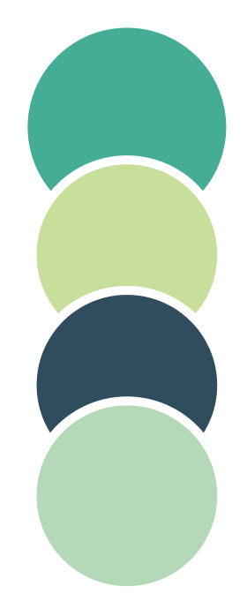
Design Justifications: Color (for grader)
Green Palette
We chose a green palette, because it is a neutral color that shows progress. Most of the screens are white with a green foreground as a simple, elegant design, which enables the user to focus more on the recipes.
On the other hand, the Home screen uses an inverted color scheme to help our text stand out and retain user interest.

